Slide 1
Cool Project

Slide 2
Context
My customer works with WordPress applications and owns an infrastructure to host them. At the moment, the customer is facing some issues regarding application availability, scalability and infrastructure reliability.
We had a meeting with the customer to understand their necessities. Now the goal is to migrate these applications to the cloud and provide a solid infrastructure to host the existing and upcoming applications.

Slide 3
Current customer infrastructure
With the meeting that we had with the customer, we identified the following technical details
10 WordPress applications, which gives us 20 applications in total
1 Database server replicated in 2 servers behind a HA proxy to achieve High Availability
Some of their websites have grown in popularity and experience instabilities in specific timeframes due to the high unexpected user traffic
Only WordPress applications will be developed
5 applications will be added in the next 12 months
The current infrastructure is managed by the customer

Slide 4
Customer requirements
The customer has listed some of their current and future necessities
High Availability
Scalability to deal with the sudden high user traffic
Flexibility to add new applications to the cloud with minimal effort
Be futureproof

Slide 5
The beginning
This is the beginning of the customer presentation.

Slide 6
Technical proposal
Given the meeting that we had with the customer, I would like to present my technical proposal for the migration of the current applications to the cloud and present the cloud architecture

Slide 7
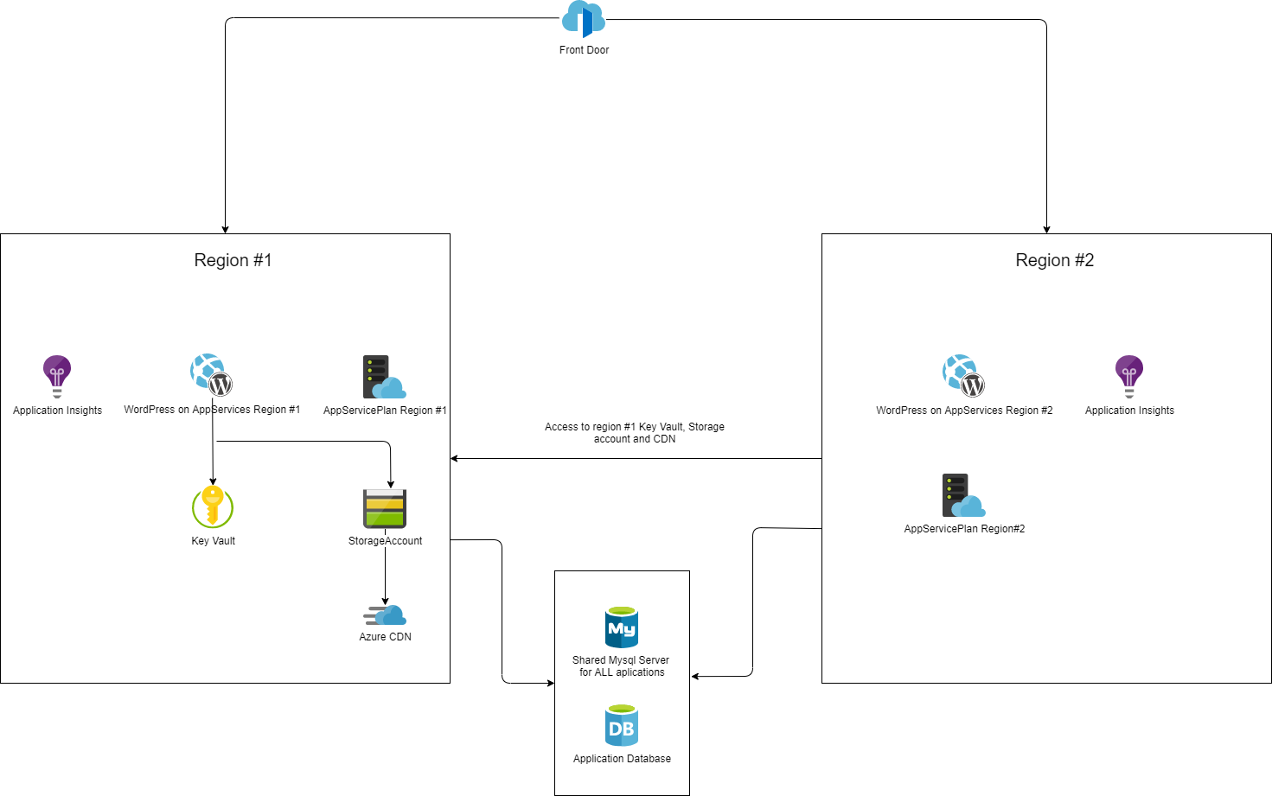

Slide 8
Infrastructure explained
Application Hosting
Applications will be hosted on AppServices
Each AppService has a generic scaling rule by default
Each AppService can have its own specific scaling rule if needed
We can scale the application based on different metrics
Autoscaling can be scheduled for specific timeframes
AppServices will have Application Insights for monitoring

Slide 9
Infrastructure explained
Application High Availability
To achieve High Availability, each application will be hosted in two different regions, known as Region#1 and Region#2
An Azure Front Door will be responsible to route the requests to the nearest available server (relative to the user)

Slide 10
Infrastructure explained
Shared Resources
Each application will have 1 Storage Account to store Media content. It will have Zone Redundant Storage for Data Redundancy.
An Azure CDN endpoint will be provided for the Storage Account
Azure CDN is chosen in favor of FrontDoor CDN due to FrontDoor being twice as expensive when compared to Azure CDN
A Key Vault will be deployed per application to store important application secrets instead of having them hardcoded into the configuration. (e.g. connection strings)
The application from Region#2 will access the Storage Account, CDN and Key Vault hosted in the Region#1 resource group

Slide 11
Infrastructure explained
Database
A database server will be shared between all applications
Each application will have 1 database
The Database Server will have metric alerts to inform about CPU usage, Memory use and more importantly, Storage size used

Slide 12
DevOps
To deliver the changes constantly made by the developer, a “DevOps environment” will be provided. This mainly consists of CI/CD pipelines to build and deploy the application to the cloud infrastructure.

Slide 13
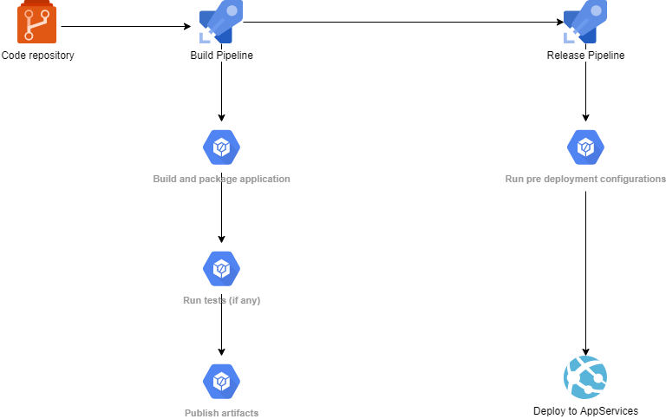

Slide 14
DevOps Specifications
Each application will have its own Build and Release pipeline which will be used to deliver the application changes to the Azure infrastructure
If any change is needed to be made in the cloud infrastructure, these changes will also be delivered through CI/CD pipelines on Azure DevOps
A pipeline will be responsible to deploy new cloud environments
There will be pipelines which will be responsible to deploy only parts of the infrastructure in case we want to update only some parts of it.
To onboard a new application, we have to:
Deploy a new cloud environment through a designated Azure DevOps release pipeline
Create a Build and Release pipeline for the new application

Slide 15
Futureproof
The current infrastructure was created using ARM Templates. This gives more confidence in the infrastructure reliability as we can keep track of changes easily using source control tools, and also makes it easy to onboard new environments
Each application can have distinct infrastructure configurations from each other as their configuration are tied to its own parameter file
In case a new service is launched, it can be integrated without too much effort by adding an ARM Template for that and integrating it into one of the main deployment ARM Templates

Slide 16
Costs Estimation
We have made a rough estimate about how much it costs to maintain an environment for a WordPress app. The prices are in Euro/Month with the assumption that all the services are going to be up every day of a month.

Slide 17
Costs Estimation
Service
Cost
Storage Account 200gb GRS
7.84
AppServices S1 2 Instances (1 per region)
148.80
CDN with 500GB traffic across all regions
56.80
Key vault
0,18
Total per highly available environment
213,62
Front Door with 1 routing rule and 100 GB outbound data transfer
39,52
Azure for MySql with 2 vCore and 200gb storage space + GRS
206,23
Standard Microsoft Support
100,00
Total per environment + Shared resources costs
581,57

Slide 18
The end
This is the end of the customer presentation.
Press -> for the next slide

Slide 19
Personal Thoughts and Considerations
Suggest to split its Dev/Test/Prod environments into different subscriptions
I thought about networking, but I dropped the idea to focus on other stuff
Security is a priority item which I did not think about for this assessment’s scope, but I know it is a very important subject in a real life scenario
Current ARM Template design are not as good as I would like. There are too many parameter files and it feels a little inflexible sometime.
I would like to use RBAC to access Key Vault and other services, but in the end I choose to finish the assessment asap.
I choose to use PaaS instead of IaaS whenever possible because my thoughts were that the customer focus was on application development, not on the infrastructure management.

Slide 20
Personal Thoughts and Considerations
I am aware about latency issues that may be caused by the fact that the apps from any of the regions may not be in the same region as the Database Server (real life experience)
To integrate with some Azure Services (i.e. Storage Account, CDN), my assumption is that the customer will use WordPress plugins for this
I tested a plugin which connects to the Storage Account and it worked quite well
The ARM Templates have some small issues which I am aware of
For example, I did not use secure string when handling the Database Server user and password. I think there are more things similar to this in the ARM Templates
This was done that way because, for this assessment scope, I wanted to focus on more important matters other than checking how to work with SecureString parameters (for this example) and troubleshooting that.

Slide 21
Personal Thoughts and Considerations
The current design does not guarantee a real High Availability for the Database and Storage Accounts.
The current design does not guarantee a real High Availability for the Database and Storage Accounts.
There is a way to circumvent that by deploying each of these services on Region#2 and copying the data daily from Region#1 to Region#2 and having applications always reading from Region#1, then using Region#2 in case Region#1 resources become unavailable for some reason
To copy the data, we can use Automation Runbooks, PowerShell scripts on Release Pipelines, LogicApps, EventHub or some other kind of tool. I believe there may be some options for that.

Slide 22
Personal Thoughts and Considerations
I never worked with WordPress in my life and I had no idea how it works. This, for me, was the hardest part of the project because I had to deal with a new technology which I had no idea about.
There was lots of effort in the making of this assessment.

Slide 23
The end
This is the real end

